Slide 1

LiDAR-based Canopy Cover prediction
October 30th Update
Alejandro Donaire Èric Sánchez Pau Ventura
Francesco Tedesco

Slide 2
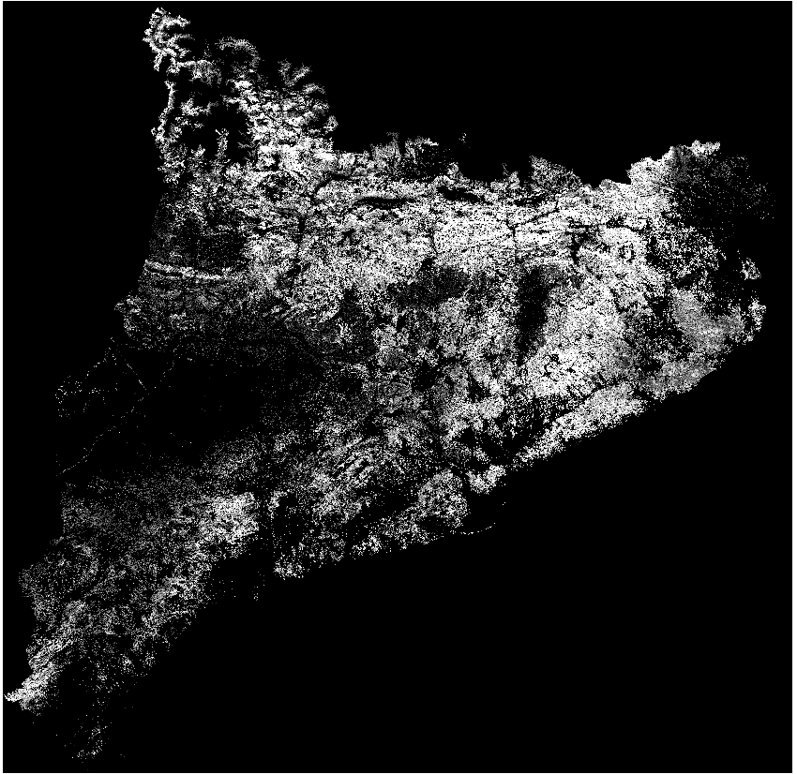
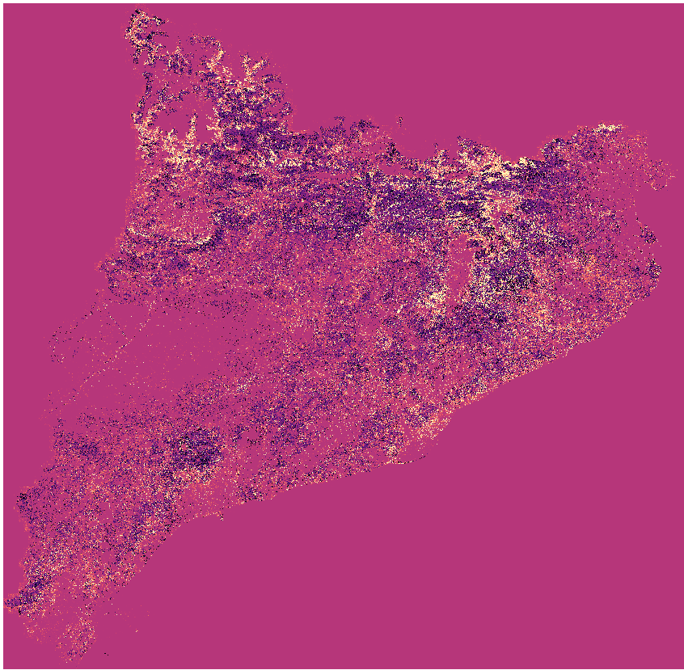


Catalunya prediction
Real
Predicted
Predicted - Real

Slide 3
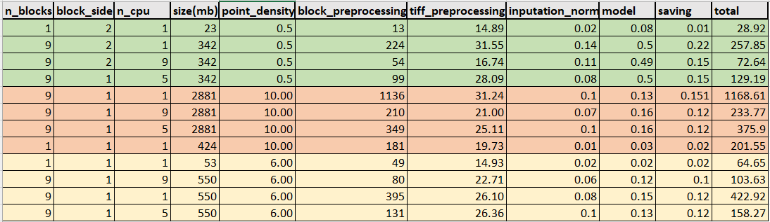
Point density execution time

Slide 4
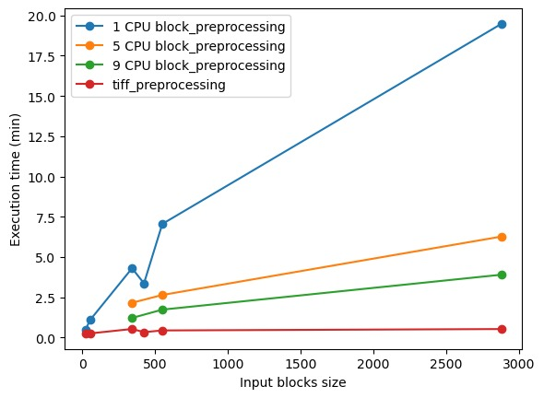
Point density execution time

